Slide 1
Intelligent classification of rural infrastructure
CAPSTONE PROJECT
Presented By:
Student Name-Rohit Lambole
College Name-MIT Academy Of Engineering
Department-Computer Engineering

Slide 2
OUTLINE
Problem Statement (Should not include solution)
Proposed System/Solution
System Development Approach (Technology Used)
Algorithm & Deployment
Result (Output Image)
Conclusion
Future Scope
References

Slide 3
Problem Statement
Rural infrastructure projects encompass diverse initiatives such as roads, water supply, sanitation, irrigation, and electrification. These projects often vary widely in scope, impact, and urgency. Traditional classification methods are manual, inconsistent, and lack real-time adaptability. This leads to delays, misallocation of resources, and inefficiencies in planning and implementation. Intelligent classification using data-driven techniques is crucial for prioritizing projects, optimizing funding, and ensuring sustainable rural development.

Slide 4
Proposed Solution
The proposed system leverages machine learning techniques deployed on IBM Cloud Lite services to automatically classify rural road and bridge construction projects under the appropriate PMGSY scheme (e.g., PMGSY-I, PMGSY-II, RCPLWEA).
The system analyzes key physical and financial characteristics of each project using a supervised learning approach to improve accuracy, consistency, and scalability over manual classification.
Key Components:
Data Collection Uses the AI Kosh dataset containing structured information on PMGSY projects.
Feature Extraction Identifies relevant features (e.g., project length, cost, location, work type) from the dataset.
Model Training Applies machine learning algorithms (e.g., Random Forest, SVM) to learn patterns from labeled data.
Automatic Classification Predicts the correct PMGSY scheme for new or existing project entries based on learned patterns.
Cloud Deployment Deploys the trained model using IBM Watson Studio, accessible via REST API for real-time classification.

Slide 5
System Approach
System Approach
The proposed system is designed to automatically classify rural infrastructure projects under various PMGSY schemes using machine learning, with deployment on IBM Cloud Lite services. The approach involves data preparation, model training, and real-time classification through cloud-based services.
1. System Requirements
To ensure smooth development, training, and deployment, the following IBM Cloud services are used:
a. IBM Cloud
Provides a scalable and secure platform to host the machine learning model
Ensures high availability and API-based access to classification services
b. IBM Watson Studio
Used to build, train, evaluate, and deploy the classification model
Offers Jupyter Notebooks, AutoAI, and visual tools for collaborative development
Supports version control and smooth deployment pipelines
c. IBM Cloud Object Storage
Stores the PMGSY dataset securely in CSV/JSON formats
Enables direct access and integration with Watson Studio for training and validation
Ensures scalability for handling large government datasets

Slide 6
Algorithm & Deployment
Algorithm and Deployment
🔹 Algorithm
Model: Random Forest Classifier (or SVM based on performance)
Reason: Efficient with structured tabular data and handles multiple features well, ideal for scheme classification tasks.
🔹 Data Input
Project features such as:
Project length
Estimated cost
Work category
State and district
Sanction year, etc.
Data sourced from the AI Kosh PMGSY dataset
🔹 Training
Type: Supervised learning
Target: PMGSY_SCHEME classification
The model learns to map input features to the correct scheme (e.g., PMGSY-I, PMGSY-II, RCPLWEA)
🔹 Deployment
Trained and deployed using IBM Watson Studio
Accessible via API endpoint for classifying new project data
Dataset stored and accessed through IBM Cloud Object Storage

Slide 7
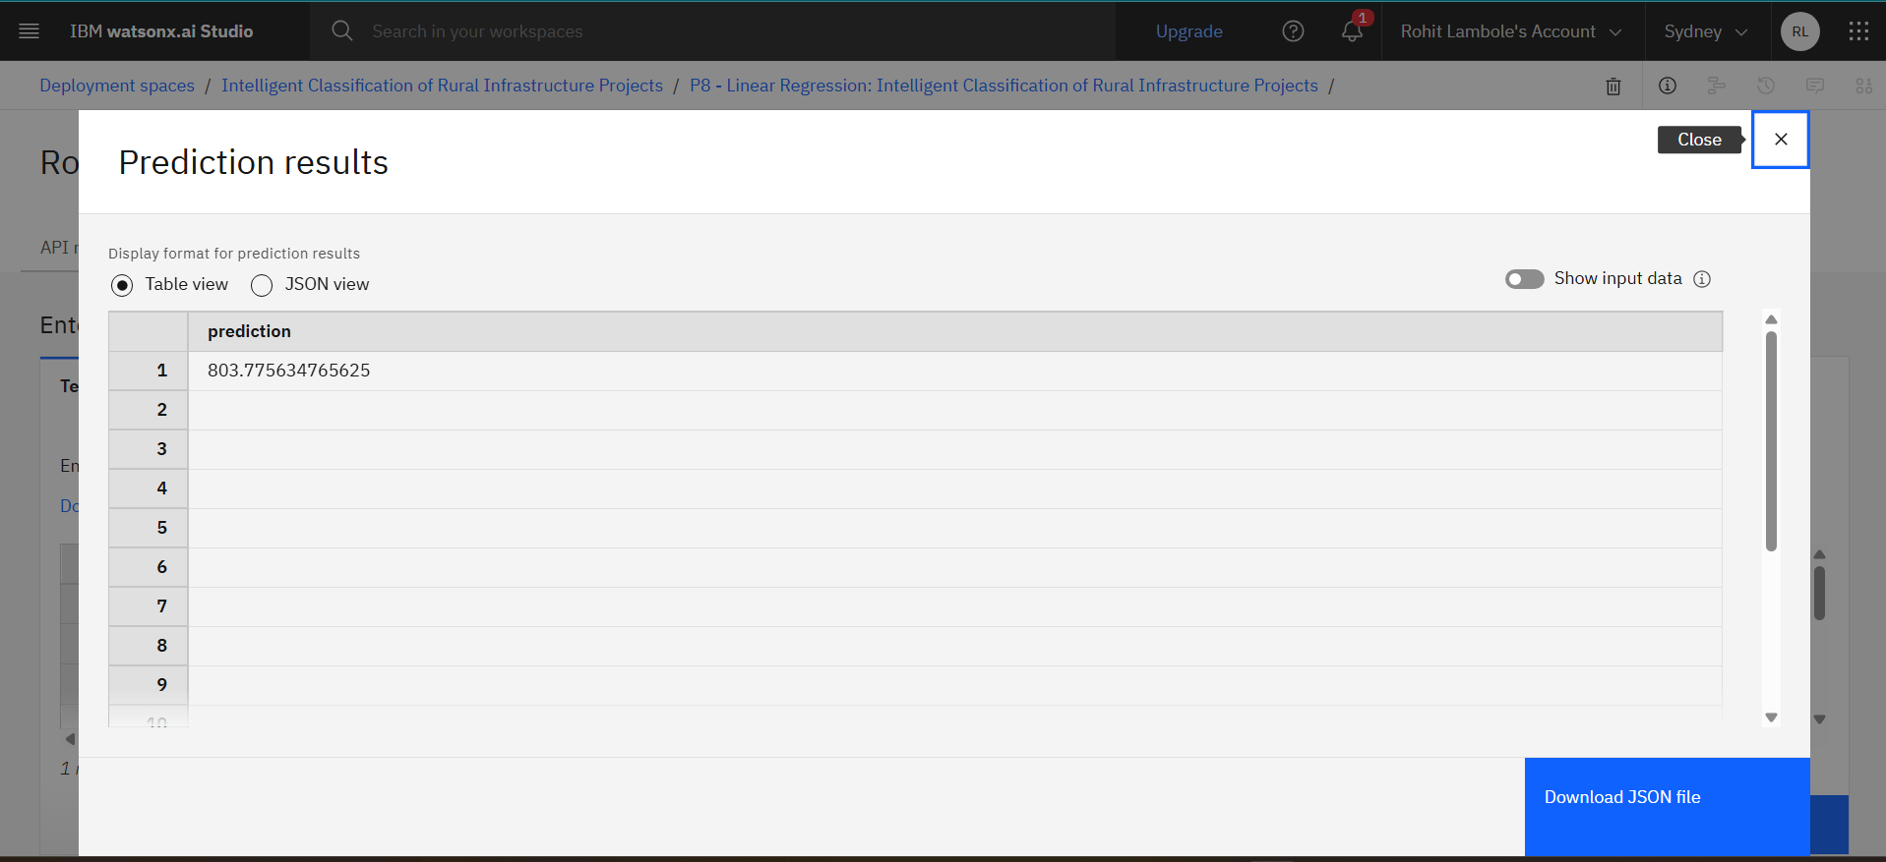
Result

Slide 8
Conclusion
The proposed machine learning model successfully automates the classification of PMGSY road and bridge projects based on physical and financial attributes. By deploying the solution on IBM Cloud Lite services, the system ensures scalability, real-time accessibility, and improved decision-making. This AI-driven approach reduces manual effort, enhances data accuracy, and supports better planning and monitoring of rural infrastructure under various PMGSY schemes.

Slide 9
Github Link:
https://github.com/RohitLambole/-Intelligent_classification_of_rural_infrastructure

Slide 10
Future scope
Future Scope
Extend the model to classify other rural development schemes beyond PMGSY
Integrate real-time project updates using IoT or government APIs
Use LSTM or deep learning for better temporal trend analysis
Add predictive analytics for early detection of project delays or cost overruns

Slide 11
References
IBM Cloud Documentation IBM Corporation. IBM Cloud Lite Services and Watson Studio Documentation. https://cloud.ibm.com/docs
Scikit-learn: Machine Learning in Python Pedregosa, F. et al., Scikit-learn: Machine Learning Library. TensorFlow: End-to-End Machine Learning Platform TensorFlow Developers. Open Source ML Framework. Government of India – PMGSY Scheme Overview Ministry of Rural Development, Government of India.

Slide 12
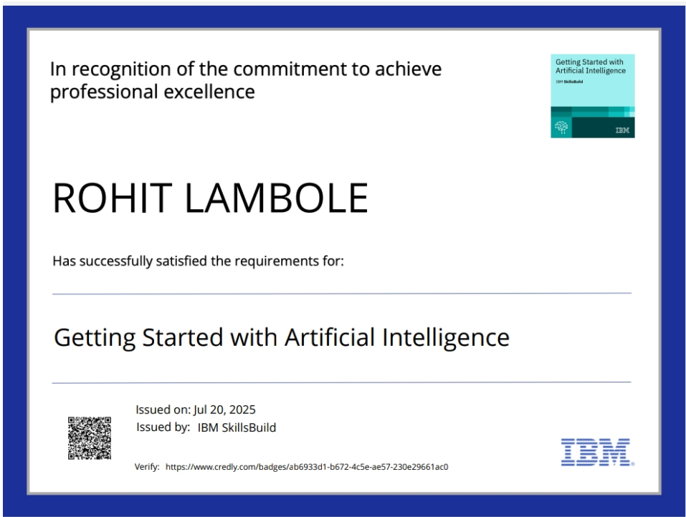
IBM Certifications

Slide 13
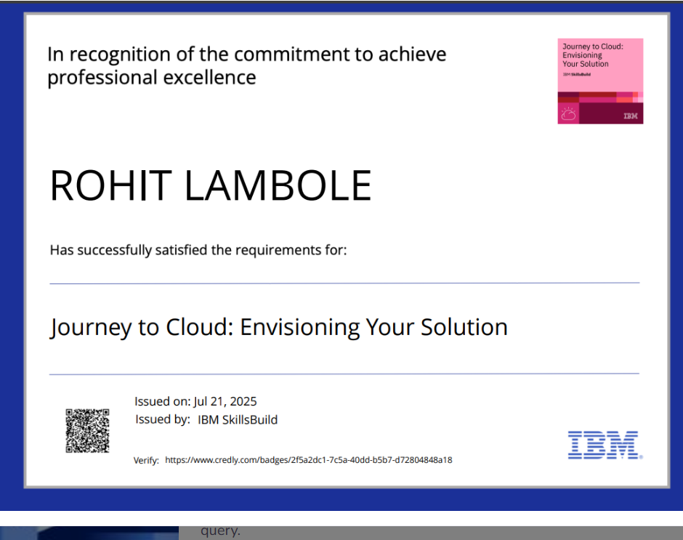
IBM Certifications

Slide 14
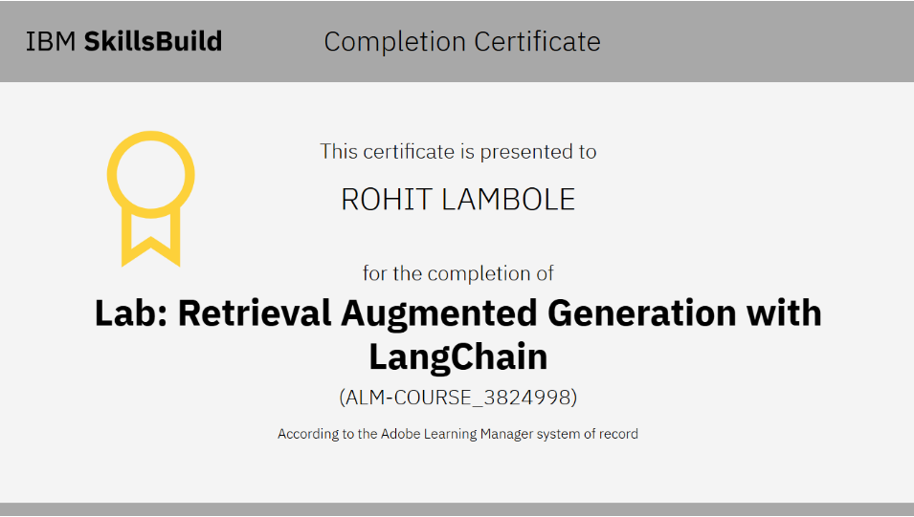
IBM Certifications

Slide 15
THANK YOU

